Slide 1
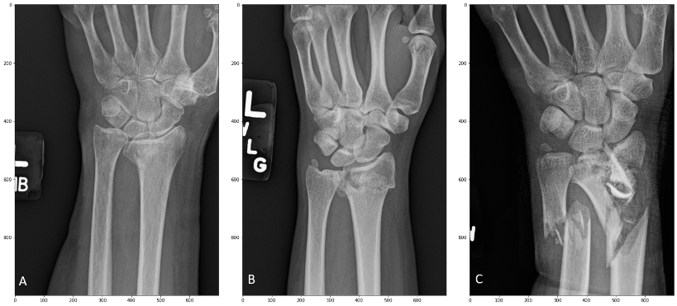
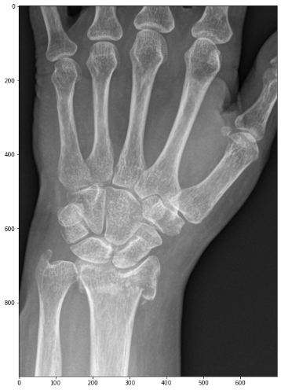
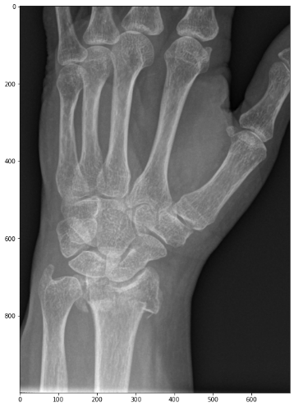
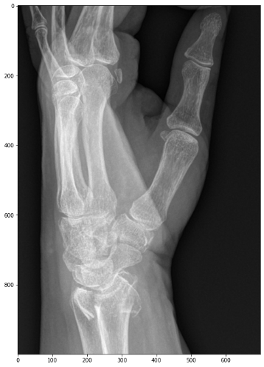
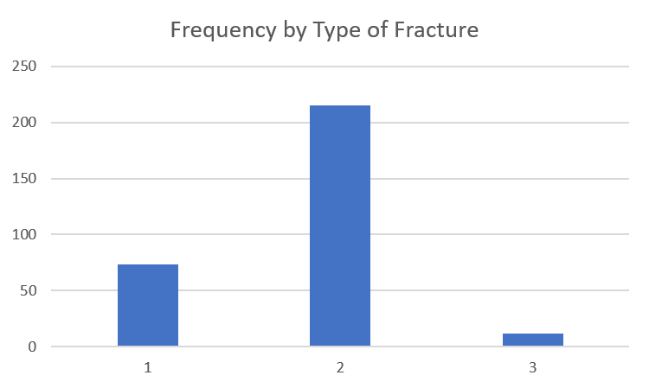
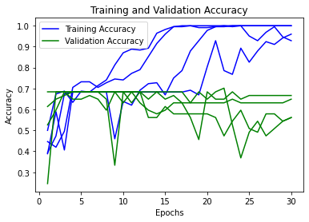
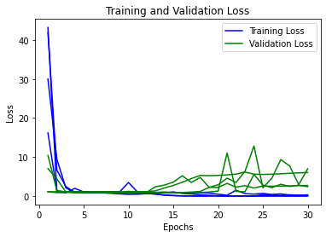
Advisor Name:
Chintan Thakkar
Grand Canyon University
Machine Learning Model for Classifying Distal Radius Fractures
A. Laurie Wells
Introduction
Distal radius fractures are the most common fractures in adults (Court-Brown & Caesar, 2006)
We have developed a classification system for distal radius fractures intended to aid clinicians in choosing appropriate treatment.
The three classifications are illustrated in figure 1. They are:
Type I: The triangular fibrocartilage complex (TFCC) and the distal portion of the interosseous forearm ligament or distal interosseous ligament (DIOL) remain intact after the distal radius fracture (DRF). There is no residual instability or subluxation of the distal radio-ulnar joint (DRUJ) after anatomical reduction of the skeletal structures. This is the injury found in minimally displaced DRF’s and in fractures of both radius and ulna which occur just proximal to the DIOL. They need no specific treatment besides restoration of the bony anatomy.
Type II: The TFCC and the extensor carpi ulnaris (ECU) tendon sheath rupture but the DIOL remains intact. DRUJ subluxation is corrected and adequate stability is restored after anatomical reduction of the skeletal structures. The distal ulna and/or the ulnar styloid may or may not be fractured. This is the concomitant DRUJ injury found in most displaced DRF’s.
Type III: The TFCC, the ECU tendon sheath, and the DIOL all rupture. Therefore all ligamentous support for the DRUJ is lost. After anatomical reduction of the skeletal structures, either subluxation of the DRUJ persists or clinical testing shows DRUJ instability. It is necessary to address the persisting DRUJ instability by specific means and early forearm rotation is usually not possible.
This presentation reports on a convolutional neural network (CNN) machine learning model to classify fractures using this system.
Methods
300 distal radius fractures were chosen from the period January 1, 2011 through December 31, 2020 from the electronic medical record system of a single level 1 trauma center.
Records were selected for which there were three x-ray views of the wrist from the original injury, posterioanterior view, oblique view, and lateral view (Figure 2).
The images were cropped so that each image was 1000 x 700 pixels.
The fractures were classified by three fellowship-trained hand surgeons.
A Python convolutional neural network (CNN) was trained/validated on 270 of the classified fractures.
Thirty (10%) of the classified fractures were used to test the CNN.
The test set results were analyzed using statistical methods.
Figure 3 shows the distribution of the fractures.
Figure 1. Three distal radius fractures A – Type I, B – Type II, and C – Type III.
A
B
C
Figure 2: Three views of a single injury, posteroanterior view (A), oblique view (B), and lateral view (C).
I
II
III
Purpose and Clinical Relavance
The objective of this project is to train, validate, and test a machine learning model to classify fractures from plain x-rays using the new classification system.
We hypothesize:
The machine learning model will classify the images more consistently than inexperienced surgeons.
The clinical relevance of this project is that it will provide guidance to surgeons when selecting appropriate surgical treatment for distal radius fracture management as well as selecting appropriate rehabilitation protocol after fracture treatment.
Results
The data was unbalanced by type
The majority of fractures were type II and there were very few type III fractures
The model did not classify type III factures well
The dataset was small and consequently suffered from overtraining
Figure 4 shows plots of training set and validation set loss and accuracy for the best model
For the best model
The trained model had an accuracy of 99.5% and a loss of 0.021 on the training set.
The trained model had an accuracy of 63.2% and loss of 8.45 on the validation set.
The trained model had an accuracy of 76.7% on the test set.
The intra-rater reliability (irr) of the best model on the test set compared favorably with the irr of the surgeons who evaluated the fractures.
Fleiss’ kappa for surgeons = 0.564, Fleiss’ kappa for one iteration of the model = 1.0
Accuracy and loss versus epoch are shown below for four instances of the model.
Conclusions
In this study, a CNN was used to classify distal radius fractures using a new classification system
The model more consistently classified the fractures than experienced surgeons
The set of classified images was small and unbalanced
Type III fractures were difficult to classify
The model suffered from overtraining
Table 1 is a confusion matrix for the test set which illustrates the problems
For future work
We will expand the training set to improve the model
The model will be deployed in a clinical setting
References
Court-Brown, C. M., & Caesar, B. (2006). Epidemiology of adult fractures: A review. Injury, 37(8), 691–697. https://doi.org/10.1016/j.injury.2006.04.130
 | Predicted |  |  | Actual Sum
Actual | I | II | III
I | 2 | 4 | 0 | 6
II | 2 | 20 | 1 | 23
III | 0 | 1 | 0 | 1
Predicted Sum | 4 | 25 | 1 | 30
We would like to acknowledge the University of New Mexico Health Sciences Center Department of Orthopaedics and Rehabilitation for the resources to complete this project.

